Slide 1
JARVIS AI Assistant
React-Based Smart Assistant

Slide 2
Project Overview
What is JARVIS?
A web-based AI assistant built using React
Inspired by Iron Man’s JARVIS
Allows users to:
  Chat with AI
  Use voice commands
  Execute system/file/email commands
  View notifications and history
Goal: Create a smart personal assistant interface.

Slide 3
Technologies Used
React JS – Frontend framework
JavaScript, HTML, CSS
Context API – Global state management
Ollama / AI API – Chat intelligence
Web Speech API – Voice recognition & speech output

Slide 4
Main Features
Chat Mode – Talk to AI like ChatGPT
Command Mode – Structured commands
Voice Mode – Speak and hear responses
Notifications – Alerts system
History – Stores past commands
Settings & Preferences – Toggle features

Slide 5
App Structure
Main Components:
App.jsx – Main controller & navigation
JARVISCore.jsx – Brain of the assistant
ChatWindow.jsx – Chat interface
VoiceFeedback.jsx – Voice input/output
TaskRouter.js – Routes commands
History.jsx – Past actions
Notifications.jsx – Alerts

Slide 6
Voice Interaction
Uses Speech Recognition to capture voice
Converts speech → text
Sends text to AI or command system
Uses Speech Synthesis to speak back
Prevents overlapping speech

Slide 7
AI Integration
Connects to Ollama / OpenAI
Generates intelligent responses
Used for:
Chat conversations
Understanding complex commands
Handles connection errors and loading states

Slide 8
Notifications & History
Notifications
Add alerts
Mark as read
Delete or clear all
History
Stores commands with time
Delete single item
Clear all history

Slide 9
How Commands Work
1. User types or speaks a command
CommandAnalyzer checks keywords
TaskRouter sends command to:
  Email Manager
  File Manager
  System Status
If unknown → AI handles it
Examples:
/check emails
/list files
/system status

Slide 10
Conclusion
What This Project Demonstrates
React Hooks & State Management
Context API usage
Voice Recognition & Text-to-Speech
AI Integration
Modular Component Design
Future Improvements
Real email/file access
Mobile optimization
User authentication

Slide 11
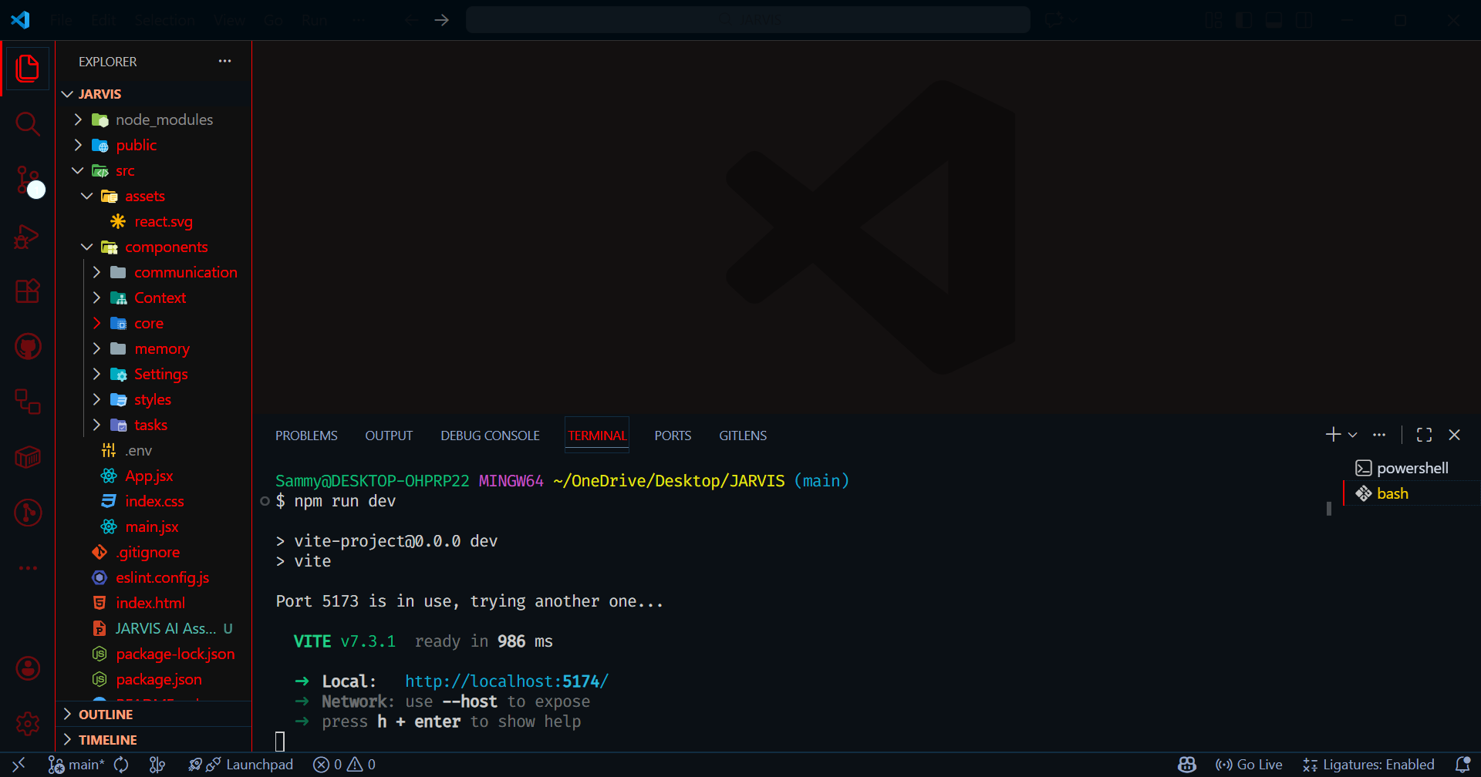
IMAGES STRUCTURE

Slide 12
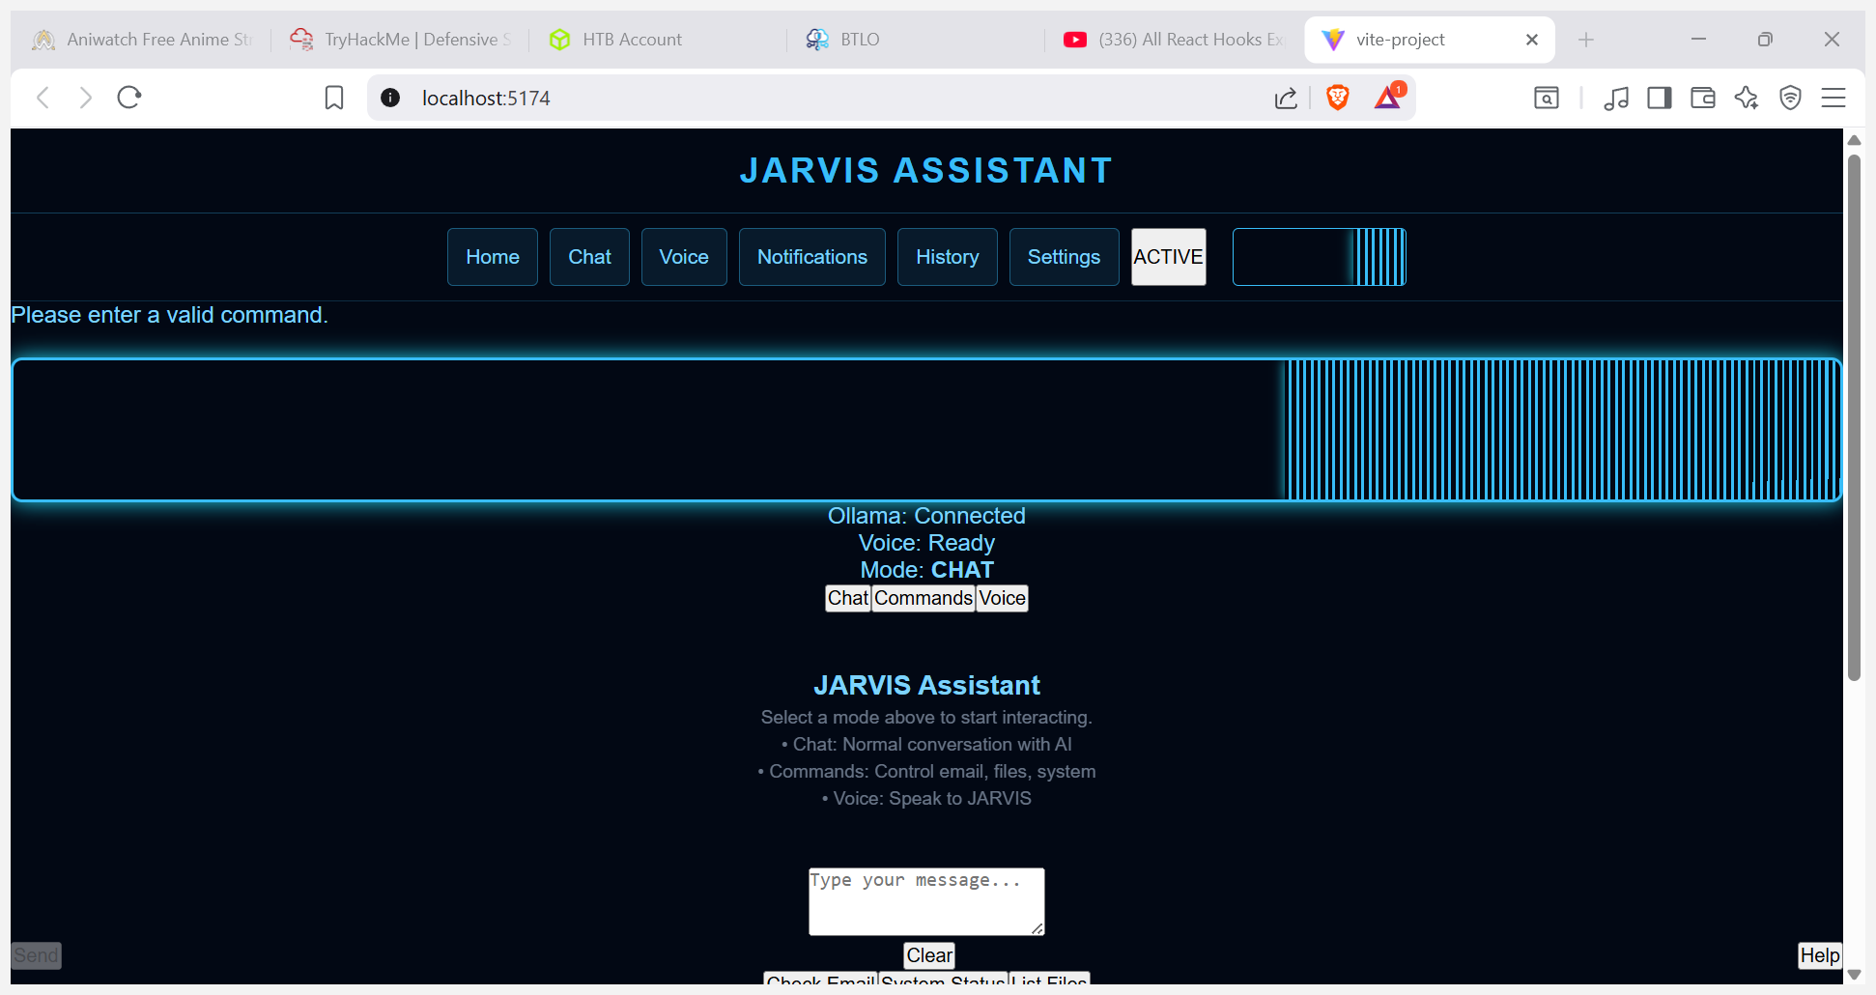
IMAGE PRESENTATION II

Slide 13
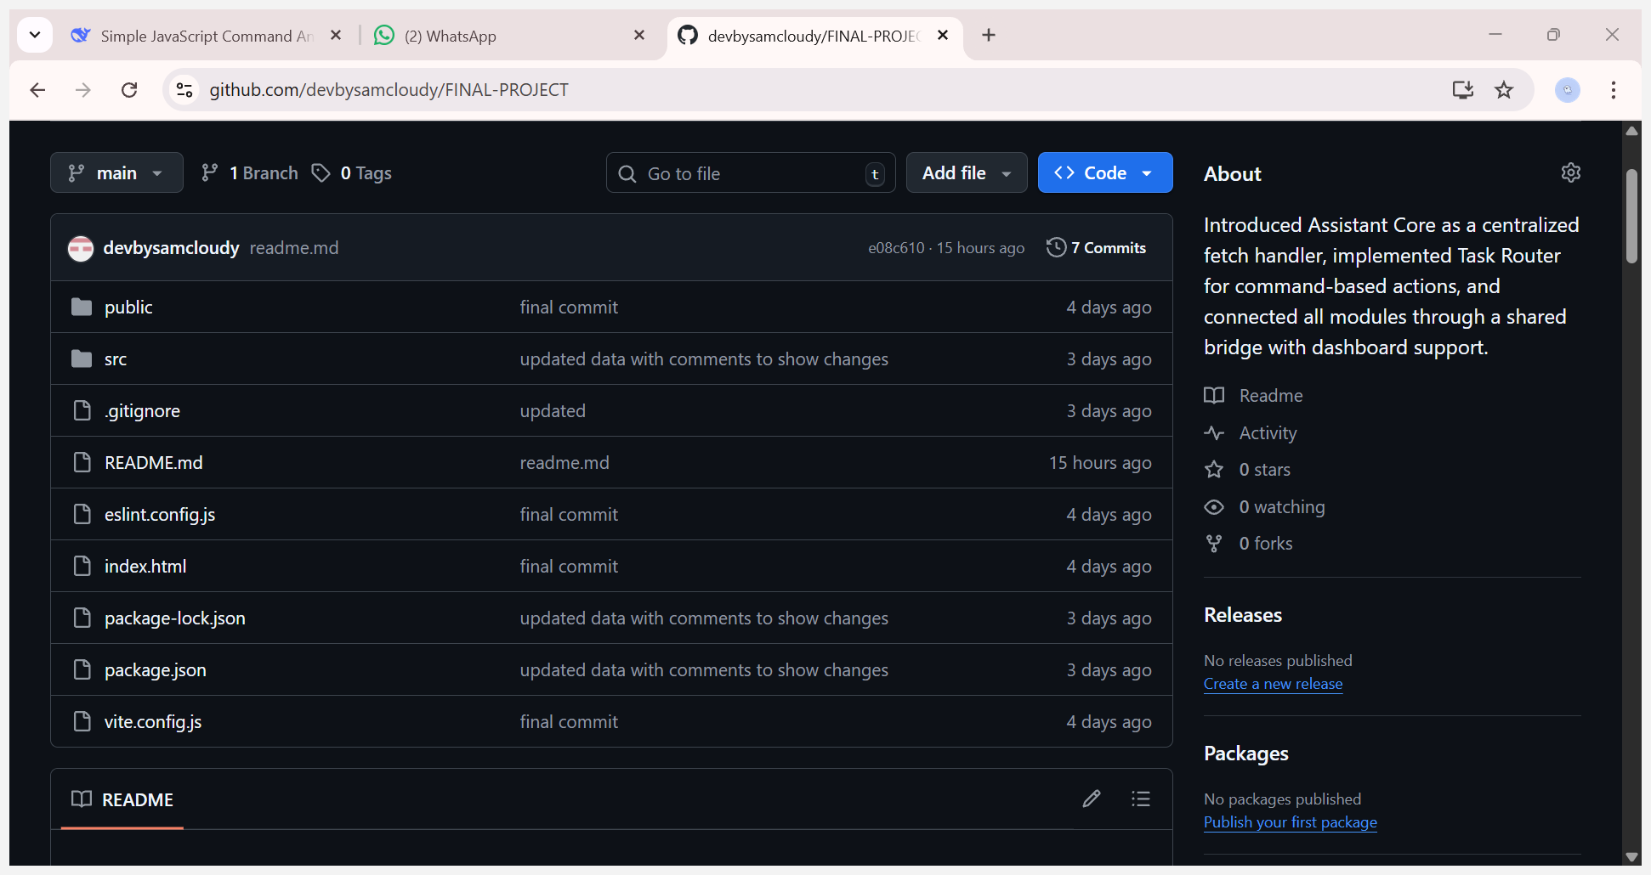
GITHUB REPO

Slide 14
MORE INFORMATION
https://github.com/devbysamcloudy/FINAL-PROJECT
PLEASE PULL THE ABOVE LINK TO GET THE CODING STRUCTURE

Slide 15
THANK YOU
AND
GOOD BYE

